Slide 1
THE BATTLE OF THE NEIGHBORHOODS
Mireya Méndez vega

Slide 2
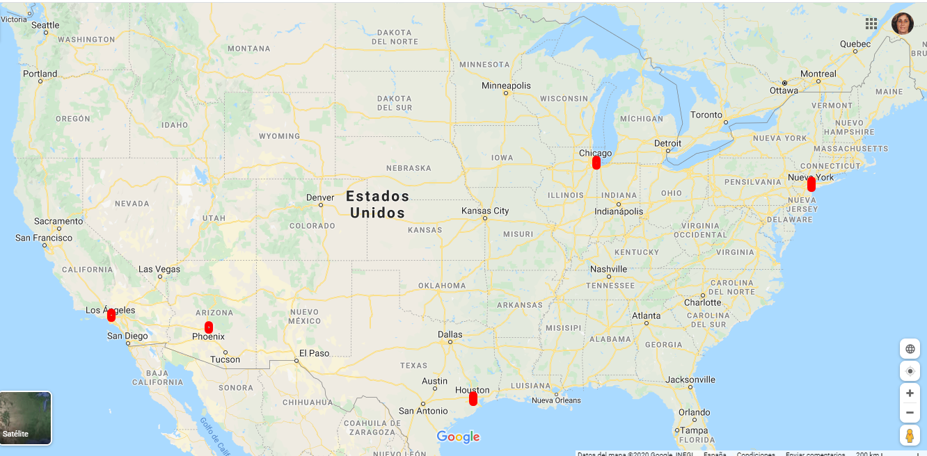
Introduction
The project will focus on the major cities in North America.
We will advise tourists where to stay if they want to eat Mexican food.

Slide 3
Data
Depending on the problem we want to solve, the factors that will influence our decision are
- The number of restaurants in the neighborhood where you will be staying during your vacation
- The number and distance of restaurants there are.
- The distance from the place you are staying to the city centre.
The tool we decided to use is the Foursquare API. We start from what is considered the center of the city that we are going to visit and focus there we will see the restaurants or Mexican food places that are there and the distance to them.

Slide 4
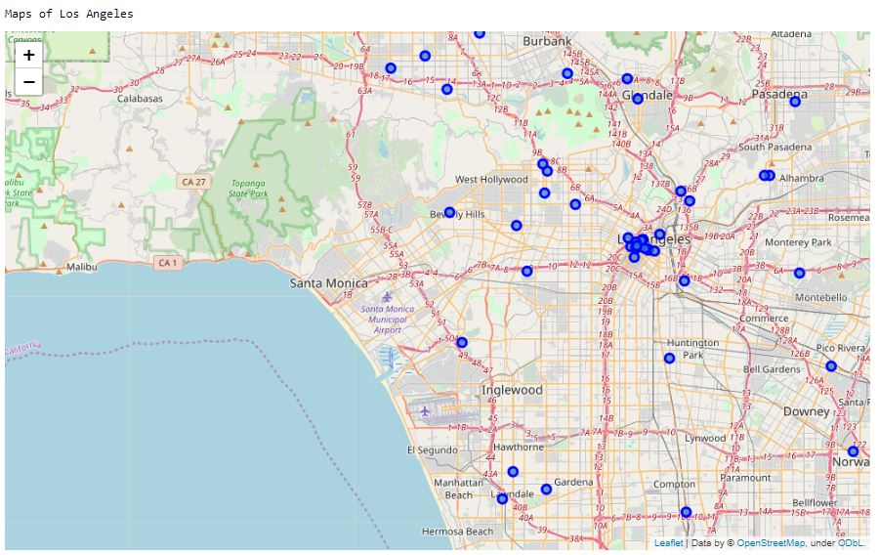
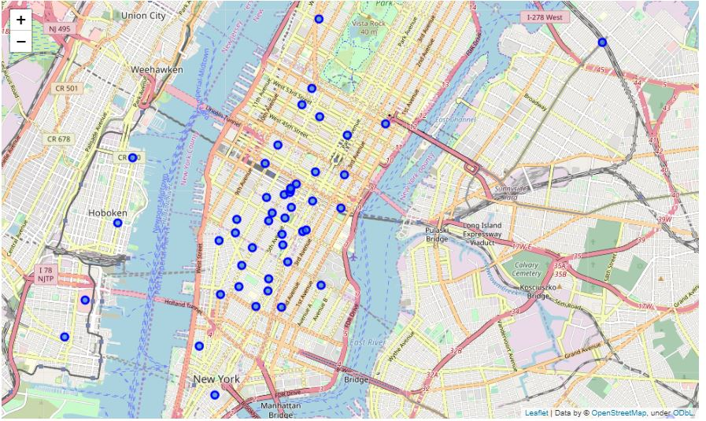
methodology
Our main objective is to stay at the hotel that has the best situation in terms of restaurants or Mexican food places depending on the city we are going to visit.
To do this we will analyze each of the maps of each city.
Here we have New York and Los Angeles

Slide 5
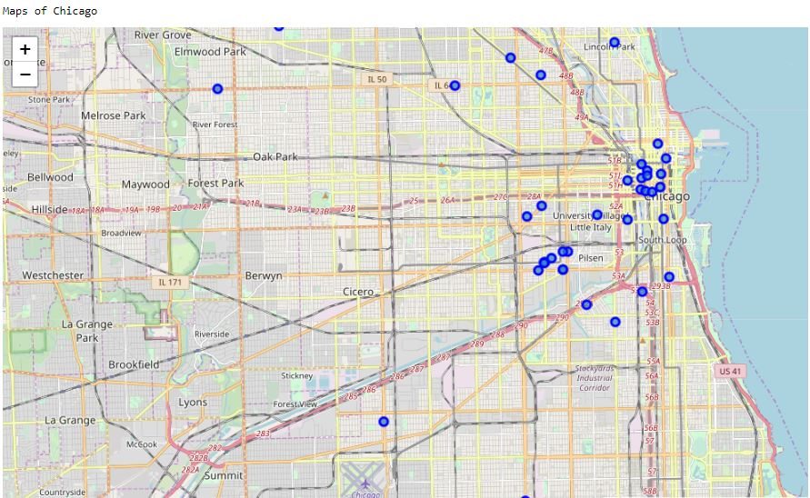
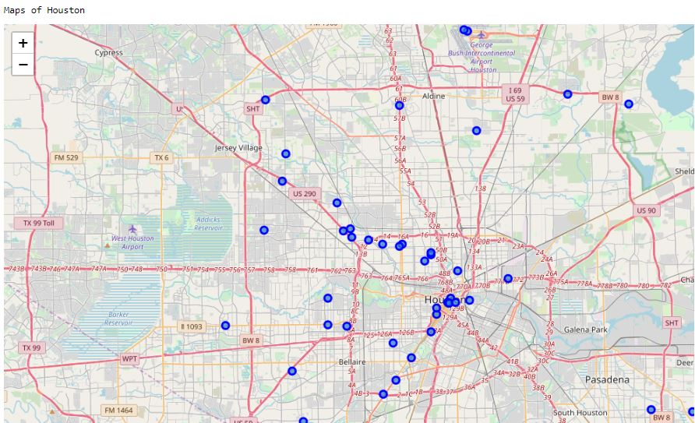
Now we see Chicago and Houston

Slide 6
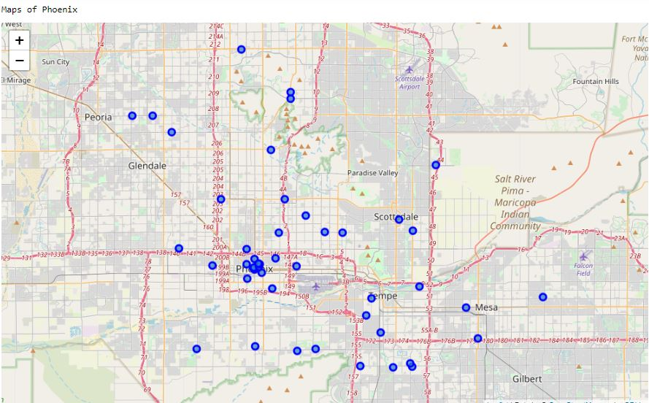
and finally Phoenix.

Slide 7
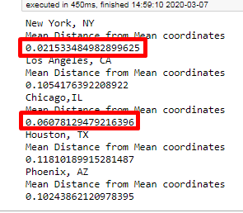
That just like in Los Angeles and Houston, we find a few restaurants or Mexican food places in the downtown area and the rest are more scattered.The next thing we do now is use some basic statistics. We will take the average distance of the places from the mean coordinates. You will see how close the points found on the map are to the center.This is a sample of the average distance of the places from the center of the cities.

Slide 8
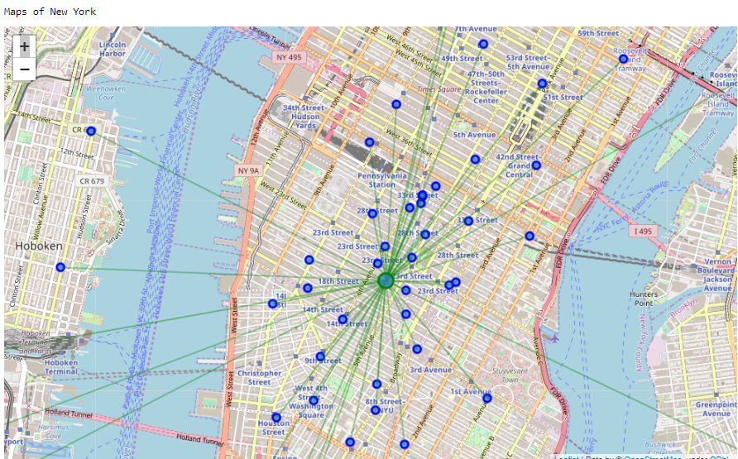
We return to see the maps, seeing the proximity to the center that is represented in each city with the green dot and closer to the maps.
The first one we see is New York.

Slide 9
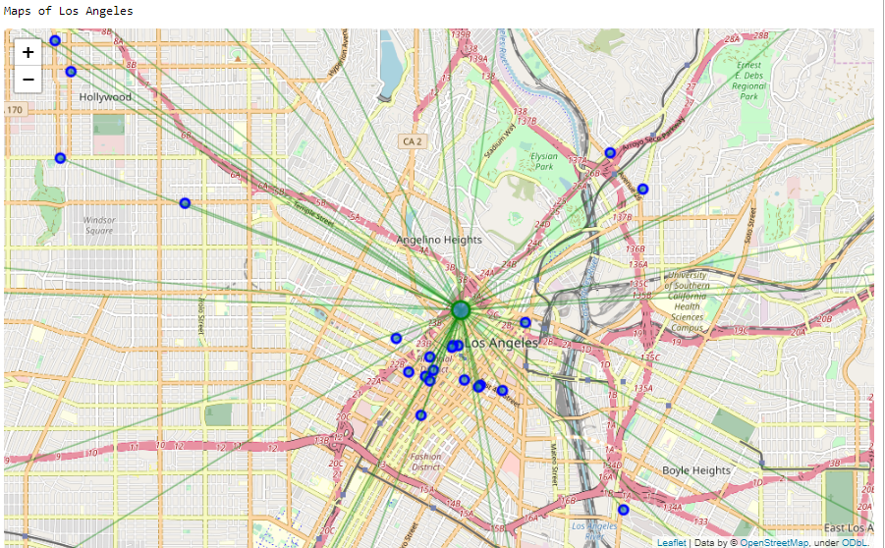
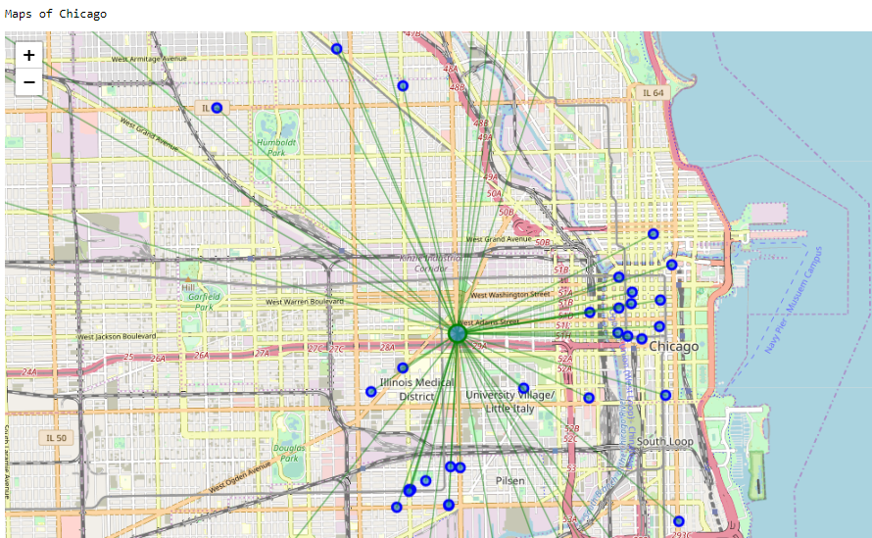
the following are Los Angeles and Chicago

Slide 10
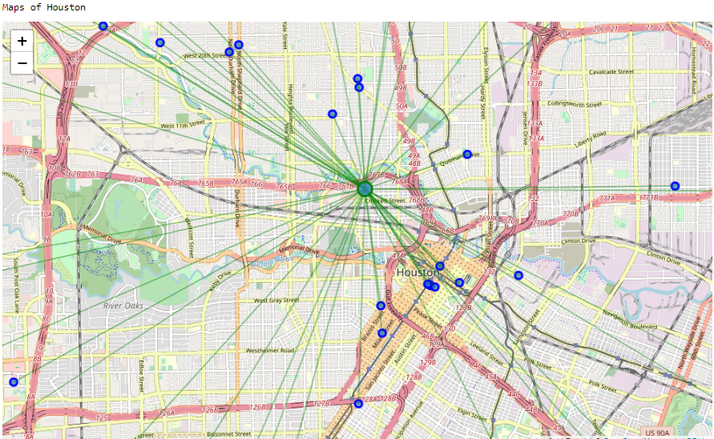
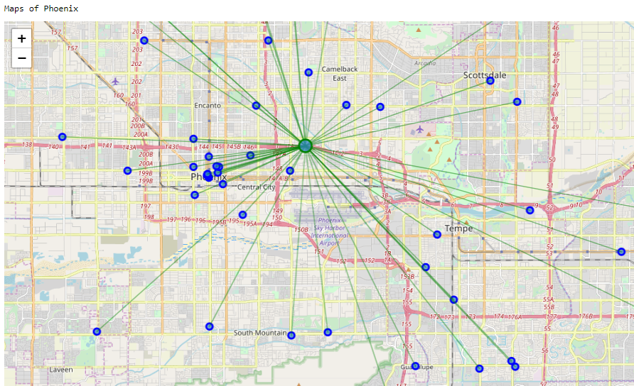
The following are Houston and Phoenix

Slide 11
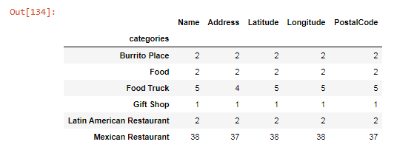
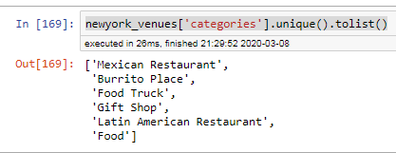
CLUSTER
Let's focus now on New York City in which we see the different categories we encounter, in our case 6 as seen in the attached image.
We look at how many guys we have in each zip code

Slide 12
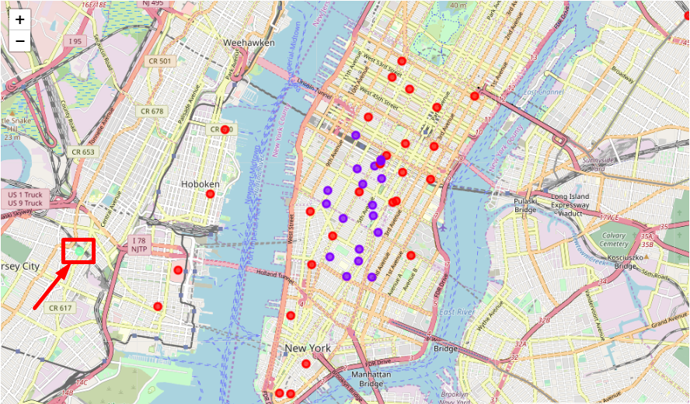
We made 3 clusters that can be seen on the map with the colors, red, purple and light green.

Slide 13
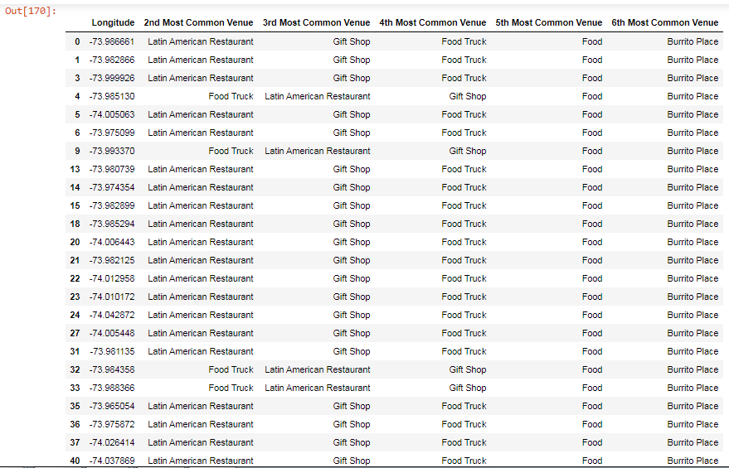
Cluster 1
As you can see in the image below, it is ordered by what it considers to be the most popular and you can see that in second place what abounds the most are the Latin American restaurants. They are represented on the map with the red dots.

Slide 14
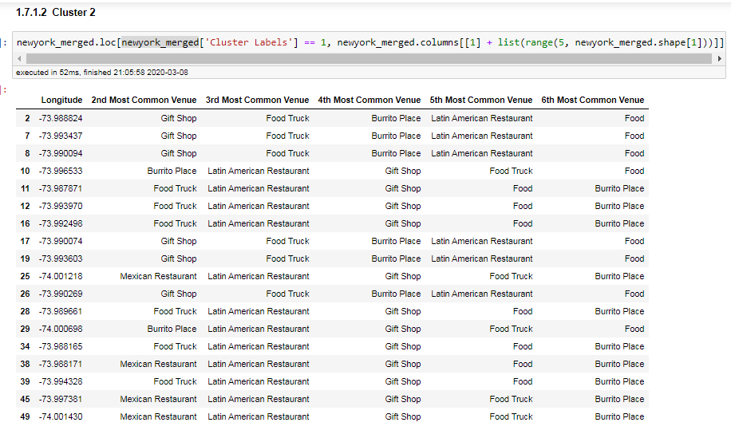
Cluster 2
In this cluster, as you can see in the image, they come much less, and are more mixed and are represented on the map with the purple points.

Slide 15
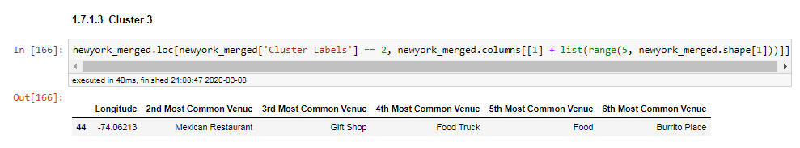
Cluster 3
As you can see in the image, we only have one represented on the map with the green dot.

Slide 16

conclusions
In this work, we are working with little data, since from each city we have obtained an approximate sample of about 50 data. Apart from the fact that the topic chosen is Mexican restaurants or places to eat, which is less typical than usual, thus reducing the sample. Anyway, looking at the maps we can extract enough information to advise tourists where to stay since we can clearly see the neighborhoods where we can find more variety of restaurants or places of that particular type of food.
THAKS!!!

